Slide 1
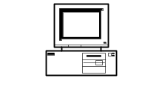
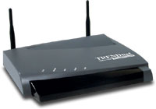

802.11 Wireless LAN
LAN Technologies
Provides network connectivity over wireless media
An Access Point (AP) is installed to act as Bridge between Wireless and Wired Network
The AP is connected to wired network and is equipped with antennae to provide wireless connectivity
Network connectivity to the legacy wired LAN
Desktop
with PCI 802.11 LAN card
Access Point
Laptop
with PCMCIA 802.11 LAN card

Slide 2
802.11 Wireless LAN
LAN Technologies
Range ( Distance between Access Point and WLAN client) depends on structural hindrances and RF gain of the antenna at the Access Point
To service larger areas, multiple APs may be installed with a 20-30% overlap
A client is always associated with one AP and when the client moves closer to another AP, it associates with the new AP (Hand-Off)
Three flavors:
  802.11b
  802.11a
  802.11g

Slide 3
Multiple Access with Collision Avoidance (MACA)
LAN Technologies
Before every data transmission
  Sender sends a Request to Send (RTS) frame containing the length of the transmission
  Receiver respond with a Clear to Send (CTS) frame
  Sender sends data
  Receiver sends an ACK; now another sender can send data
When sender doesn’t get a CTS back, it assumes collision
other node in
sender’s range
sender
receiver
other node in
receiver’s range
RTS
CTS
data
ACK

Slide 4
WLAN : 802.11b
LAN Technologies
The most popular 802.11 standard currently in deployment.
Supports 1, 2, 5.5 and 11 Mbps data rates in the 2.4 GHz ISM (Industrial-Scientific-Medical) band

Slide 5
WLAN : 802.11a
LAN Technologies
Operates in the 5 GHz UNII (Unlicensed National Information Infrastructure) band
Incompatible with devices operating in 2.4GHz
Supports Data rates up to 54 Mbps.

Slide 6
WLAN : 802.11g
LAN Technologies
Supports data rates as high as 54 Mbps on the 2.4 GHz band
Provides backward compatibility with 802.11b equipment

Slide 7
Repeater, HUB, Bridge & Switch
REPEATER, HUB, BRIDGE AND SWITCH

Slide 8
Repeater
Repeater, Hub, Bridge & Switch
A repeater receives a signal, regenerates it, and passes it on.
It can regenerate and retime network signals at the bit level to allow them to travel a longer distance on the media.
It operates at Physical Layer of OSI
The Four Repeater Rule for 10-Mbps Ethernet should be used as a standard when extending LAN segments.
This rule states that no more than four repeaters can be used between hosts on a LAN.
This rule is used to limit latency added to frame travel by each repeater.

Slide 9
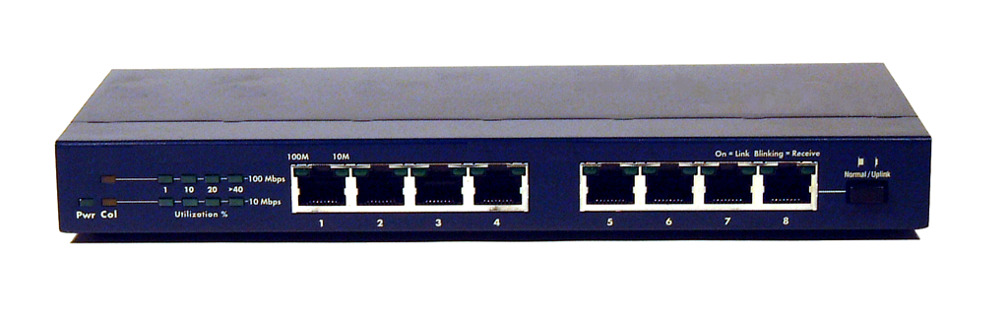
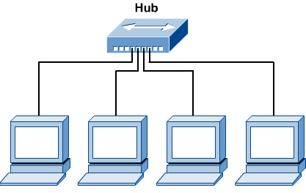
Hub
Repeater, Hub, Bridge & Switch
Hubs are used to connect multiple nodes to a single physical device, which connects to the network.
Hubs are actually multiport repeaters.
Using a hub changes the network topology from a linear bus, to a star.
With hubs, data arriving over the cables to a hub port is electrically repeated on all the other ports connected to the same network segment, except for the port on which the data was sent.

Slide 10
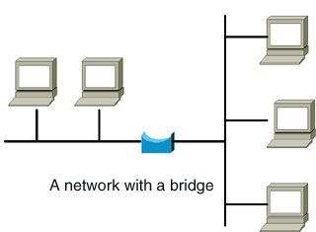
Bridge
Repeater, Hub, Bridge & Switch
Bridges are used to logically separate network segments within the same network.
They operate at the OSI data link layer (Layer 2) and are independent of higher-layer protocols.
The function of the bridge is to make intelligent decisions about whether or not to pass signals on to the next segment of a network.
When a bridge receives a frame on the network, the destination MAC address is looked up in the bridge table to determine whether to filter, flood, or copy the frame onto another segment
Broadcast Packets are forwarded

Slide 11
Switch
Repeater, Hub, Bridge & Switch
Switches are Multiport Bridges.
Switches provide a unique network segment on each port, thereby separating collision domains.
Today, network designers are replacing hubs in their wiring closets with switches to increase their network performance and bandwidth while protecting their existing wiring investments.
Like bridges, switches learn certain information about the data packets that are received from various computers on the network.
Switches use this information to build forwarding tables to determine the destination of data being sent by one computer to another computer on the network.

Slide 12

Switches: Dedicated Access
Repeater, Hub, Bridge & Switch
Hosts have direct connection to switch
Full Duplex: No collisions
Switching: A-to-A’ and B-to-B’ simultaneously, no collisions
Switches can be cascaded to expand the network
A
C’
B
switch
C
B’
A’

